Slide 1
PARKINSONS DISEASE
Dr. Gaurav C. Mhaske
Dept. Of Neurophysiotherapy
MGM Institute Of Physiotherapy
Chh. Sambhajinagar

Slide 2
History of Parkinson´s disease (PD)
First described in 1817 by an English physician, James Parkinson, in “An Essay on the Shaking Palsy.”
The famous French neurologist, Charcot, further described the syndrome in the late 1800s.
Epidemiology of PD
The most common movement disorder affecting 1-2 % of the general population over the age of 65 years.
The second most common neurodegenerative disorder after Alzheimer´s disease (AD).

Slide 3
Introduction
PARKINSONS DISEASE is a chronic progressive disease of nervous system characterized by cardinal features of rigidity, bradykinesia, tremors and postural instability.
In addition the disease may cause a variety of other symptoms including movement and gait disturbances, sensory changes, speech, voice and swallowing disorders, cognitive and behavioral changes, ANS dysfunction, GI changes and cardiopulmonary changes.

Slide 4
A progressive neurodegenerative disorder characterized by the loss of dopaminergic neurons in the substantia nigra of the brain
Affects movement
Although PD isn’t fatal, it is progressive and incurable
Even with medications, symptoms vary in incidence, severity, and timing from person to person day to day

Slide 5
Four Primary Symptoms of PD
Tremor/trembling in limbs, jaw and face (at rest) Most common first symptom, usually asymmetric and most evident in one hand with the arm at rest.
Rigidity or stiffness of the limbs and trunk, Muscle tone increased in both flexor and extensor muscles providing a constant resistance to passive movements of the joints; stooped posture, anteroflexed head, and flexed knees and elbows
Akinesia (lack/slowness of initiating or maintaining movement) Difficulty with daily activities such as writing, shaving, using a knife and fork, and opening buttons; decreased blinking, masked facies, slowed chewing and swallowing.
Postural instability/impaired balance and coordination due to loss of postural reflexes Loss of postural reflexes causes balance difficulties and the body can move or fall into the direction of the center of gravity. Therefore, turning or bending forward may be associated with involuntary steps

Slide 6
Other Signs and Symptoms
Dysfunction of the autonomic nervous system: Impaired gastrointestinal motility, bladder dysfunction, sialorrhea, excessive head and neck sweating, and orthostatic hypotension.
Autonomic dysfunction can result into impaired gastrointestinal motility causing sense of fulness and constipation.
Furthermore, bladder dysfunction (urinary frequency, urgency and urge incontinence), sialorrhea (due to excessive saliva production and decreased frequency of swallowing), excessive head and neck sweating (resulting from altered thermoregulation), and orthostatic hypotension result from autonomic dysfunction
Depression: Mild to moderate depression in 50 % of patients.
Cognitive impairment: Mild cognitive decline including impaired visual-spatial perception and attention, slowness in execution of motor tasks, and impaired concentration in most patients; at least 1/3 become demented during the course of the disease.

Slide 7
Classification of Parkinsonism
Idiopathic PD
PD due to identifiable causes e.g. viruses, toxins, drugs, vascular diseases, tumors, normal pressure hydrocephalous, metabolic.
PD in other Neurodegenerative disorders

Slide 8
Neuropathology of PD
Eosinophilic, round intracytoplasmic inclusions called lewy bodies and Lewy neurites.
First described in 1912 by a German neuropathologist - Friedrich Lewy.
Inclusions particularly numerous in the substantia nigra pars compacta.
Later the focal distribution of pathology was shown: the most pronounced nerve cell loss is found in the pars compacta of the substantia nigra.

Slide 9
Lewy bodies

Slide 10
On the left a Lewy body of substantia nigra section from a PD patient labeled with a polyclocal α-synuclein antibody NAC-1 at 1:100. On the right cortical Lewy bodies of cingulate gyrus labelled with NAC-1 at 1:200. Bars 20 μm.
α-synuclein accumulates in Lewy bodies in Parkinson's disease and dementia with Lewy bodies but not in Alzheimer's disease -amyloid plaque cores.
The presence of Lewy bodies is not limited to substantia nigra: they are also found in the locus coeruleus, motor nucleus of the vagus nerve, the hypothalamus, the nucleus basalis of Meynert, the cerebral cortex, the olfactory bulb and the autonomic nervous system. Lewy bodies are confined largely to neurons; glial cells are only rarely affected.

Slide 11
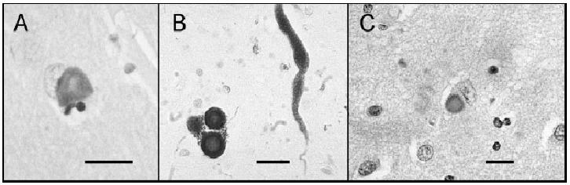
Lewy bodies

Slide 12
Functional neuroanatomy of PD
Substantia nigra is the major origin of the dopaminergic innervation of the striatum and is a part of extrapyramidal system which processes information coming from the cortex to the striatum, and returns it back to the cortex through the thalamus.
One major function of the striatum, which is under the control of substantia nigra, is the regulation of posture and muscle tonus.

Slide 13
CORTEX
+
+
STRIATUM
D1
D2
D1
SNc
GPe
−
SNr
STN
GPi
+
+
THALAMUS
NORMAL MOTOR CONTROL

Slide 14
Neurochemistry of PD
In late 1950s, it was shown that dopamine is present in mammalian brain, and that the levels are highest within the striatum.
In 1960, Ehringer and Hornykiewicz showed that the levels of dopamine are severely reduced in the striatum of patients with PD.
Degeneration of the nigrostriatal dopaminergic neurons causes symptoms of PD: symptoms become manifest when about 50-60 % of the dopamine-containing neurons in the substantia nigra and 70-80 % of striatal dopamine are lost.

Slide 15
Dopamine pathways in human brain
The ventral tegmental area (VTA) cells project to limbic (mesolimbic projection) and cortical (mesocortical projection) areas.
Neurons of the substantia nigra project to the striatum (nigrostriatal projection).
In PD, dopaminergic nerve cells in the substantia nigra develop nerve cell loss, and its degeneration and the resulting striatal dopamine depletion are responsible for most of the motor abnormalities.

Slide 16
Hoen and Yahr Classification
I Minimal or absent; unilateral if present
II Minimal bilateral or midline involvement, Balance not impaired
III Impaired righting reflexes, unsteadiness when turning or rising from chair. Some activities are restricted, but patient can live independently and continue some forms of employment
IV All symptoms present and severe. Standing and walking possible only with assistance
V Confined to bed or wheelchair.

Slide 17
Treatment of PD
No cure currently exists
Treatment does not stop the progression of the disease
Offers symptomatic relief
Can temporarily restore function
Can enhance Quality Of Life
Each individual responds to drugs differently

Slide 18
Pharmacological Treatment
Mild symptoms may not require medication
When prescription drugs are needed, they help to manage symptoms, but cannot stop the progression of the disease
When a drug no longer effectively controls symptoms, another drug may be added to existing therapy
Optimal management is highly individualized and is best determined by a doctor who specializes in the treatment of PD

Slide 19
Medications
Levodopa
Converted to dopamine in the brain, which is responsible for transmitting signals in the brain allowing for normal movements
Often combined with Carbidopa (Sinemet), which ↑ the amount of Levodopa that goes to the brain
COMT inhibitors
Blocks the action of catechol-O-methyltransferase, an enzyme that breaks down dopamine.
Entacapone (Comtan) and Tolcapone (Tasmar)

Slide 20
Medications
Dopamine agonists
Act like dopamine within the brain
Bromocriptine (Parlodel), Pramipexole (Mirapex), Ropinirole (Requip), and Apomorphine (Apokyn)
Amantadine
Unknown mechanism; may ↑ brain’s response to dopamine or releases stored dopamine
Amantadine (Symmetrel)

Slide 21
Medications
Anticholinergics
Exert a relaxing effect on the body
Benztropine Mesylate (Congetin), Procyclidine (Kemadrin), Biperiden (Akineton), and Trihexyphenidyl
Selegiline
Unknown mechanism
Appears to inhibit the breakdown of dopamine
Usually added to a patient’s therapy when effectiveness of Levodopa is ↓
Selegiline (Zalapar, Eldepyrl, Emsam)

Slide 22
Stereotactic Surgery and Parkinson's Disease
Functional neurosurgery comprises treatment of several disorders such as Parkinson’s disease, hyperkinesis, disorder of muscle tone, intractable pain, convulsive disorders and psychological phenomena. Treatment for these phenomena was believed to be located in the superficial parts of the CNS and PNS. Most of the interventions made for treatment consisted of cortical extirpation.
To alleviate extra pyramidal disorders, pioneer Russell Meyers dissected or transected the head of the caudate nucleus in 1939, and part of the putamen and globus pallidus. Attempts to abolish intractable pain were made with success by transaction of the spinothalamic tract at spinal modullary level and further proximally, even at meencephalic levels.

Slide 23
In 1939-1941 Putnam and Oliver tried to improve Parkinsonism and hyperkinesias by trying a series of modifications of the lateral and antero-lateral cordotomies. Additionally, other scientists like Schurman, Walker, and Guiot made significant contributions to functional neurosurgery.
In 1953, Cooper discovered by chance that ligation of the anterior chorioidal artery resulted in improvement of Parkinson's disease. Similarly, when Grood was performing an operation in a patient with Parkinson’s, he accidentally lesioned the thalamus. This caused the patient’s tremors to stop. From then on, thalamic lesions became the target point with more satisfactory results.

Slide 24
More recent clinical applications were seen at the University of Virginia School of Medicine, where Deep Brain Stimulation (DBS), Pallidotomy and Thalamotomy are surgeries used to treat Parkinson’s disease.
During DBS, an electrode is placed into the thalamus, the pallidum of the subthalmamic nucleus, parts of brain that are involved in motor control, and are affected by Parkinson’s Disease.
The electrode is connected to a small battery operated stimulator that is placed under the clavicle, where a wire runs beneath the skin to connect it to the electrode in the brain. The stimulator produces electrical impulses that affect the nerve cells around the electrode and should help alleviate tremors or symptoms that are associated with the affected area.

Slide 25
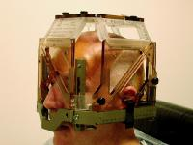
Deep brain stimulation

Slide 26
In Thalamotomy, a needle electrode is placed into the thalamus, and the patient must cooperate with tasks assigned to find the affected area- after this area of the thalamus is located, a small high frequency current is applied to the electrode and this destroys a small part of the thalamus. Approximately 90% of patients experience instantaneous tremor relief.
In Pallidotomy, an almost identical procedure to thalamotomy, a small part of the palladium is destroyed and 80% of patients see improvement in rigidity and hypokinesia and a tremor relief or improvement comes weeks after the procedure.

Slide 27
Goals of PT Treatment
Fall prevention
Correct deficits
Transfers and bed mobility
Strengthening of trunk, shoulders, hips
Balance and coordination
  Swiss ball exercises
  Squats
  Reaching out beyond BOS
  Weight shifting – marching, kicking ball

Slide 28
PD patients with more than 1 fall in previous year are likely to fall again
Most falls occur during transfers and freezing of gait
Therefore, PT should focus on:
  Promoting active lifestyle
  Active exercises to improve balance, muscle power, joint mobility, and aerobic capacity
  Cueing strategies
  Postural adjustments in bed or W/C
  Assisted active exercises
  Education to prevent pressure sores and contractures

Slide 29
Abnormal Gait Patterns with PD
Difficulty weight shifting or initiating movement
Hypokinesia, associated with reduced walking speed and step length
Episodes of “freezing” motor blocks
Impaired balance and postural reactions
↓ upright stance with narrow BOS

Slide 30
Cueing Strategies
Used during gait training
  Auditory cues – rhythmic music, metronome, counting
  Visual cues – stepping over stripes on floor, focus on an object, colors
  Tactile cues – tapping on hip, leg, etc.
  Cognitive cues – mental image of appropriate step length

Slide 31
Exercises
Focus on ROM, gait, balance, antirigidity, ADLs
Leg strength – use equipment, resistive bands
Balance/sway – foam pads, wobble boards, swiss ball
Strengthen trunk muscles for respiration and posture
Weight shifting
Exercises for transfers

Slide 32
Exercises
Stretching exercises are essential
  Posterior direction: reaching backwards, walking backwards
  Extension exercises
  Throwing/kicking a ball
  Push-ups
PROM
PNF
Respiration exercises
Relaxation exercises – Yoga, Tai Chi
Karate exercises – shown to ↓ tremors and ↑ dexterity and coordination
  Energy Conservation

Slide 33
Tai Chi
The slow, rhythmic pace of functionally based exercises, helps in internal organ stimulation, flexibility maintenance, balance training effects are general health benefits of Tai Chi
Relevant to PD management: fall prevention, tremor reduction, and motor control

Slide 34
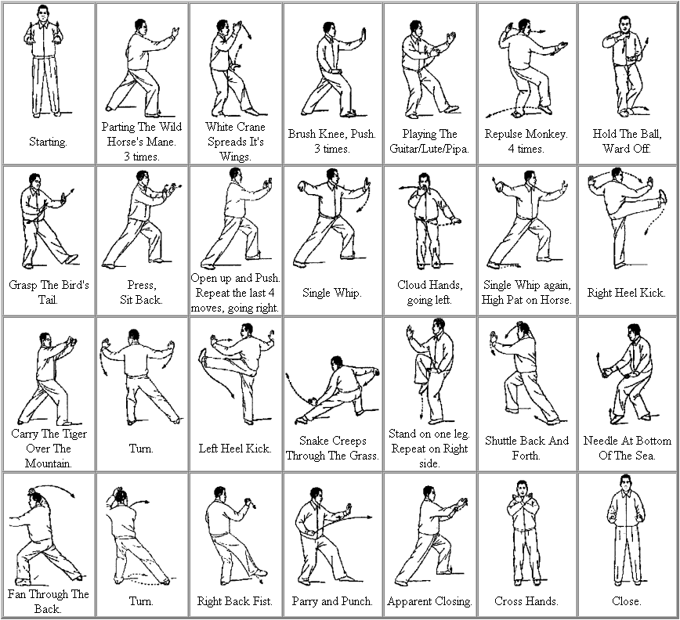

Slide 35
Balance Training & High-Intensity Resistance Training
PD patients have dyssynchrony of leg muscles during movement initiation
  Reduced peak torque production in knee extension, flexion, and ankle dorsiflexion
LE weakness impairs postural responses to challenged balance
High intensity resistance training of knee extensors, flexors, ankle plantarflexors
Cycle ergometer

Slide 36
Treadmill Training
Many studies conducted and treadmill training shown to be effective in gait training
At initial sessions, all patients could walk without freezing phenomenon at higher treadmill speeds
Improvement in gait speed and number of steps
Effects lasted for less period of time

Slide 37
Treadmill Training
Possible that body-weight supported (overhead suspension harness) treadmill training induces implicit motor learning by enhancing alternative brain networks
Has potential to enhance gait rhythmicity
Progressive and intensive treadmill training can minimize impairments in gait, reduce fall risk and ↑ quality of life
Positive Aspects of treadmill training:
  Rhythmicity
  Weight-support
  Aerobic training
  External pacemaker

Slide 38
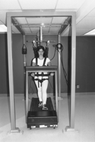

Slide 39
Stretch Reflex – Trager Method
↑ muscle rigidity hypothesized to be caused by enhanced activity of a “long latency” component of the stretch reflex
Manual segmental vibration characteristic of the Trager method, consists of imparting low-frequency movements to a limb to produce a brief but substantal reduction in the H-reflex (stretch reflex)
Suggests that imparting rocking motions to a body segment can alter the activity of the reflex pathways

Slide 40
Stretch Reflex
Trager Approach: imparts a series of very gently painless, passive rocking motions to the limbs
Significant reduction of evoked stretch response was observed; may induce a reduction of the muscle rigidity seen in patients with PD
More effective in supine than sitting

Slide 41


Slide 42
Lastly
Family & Patient Education

Slide 43
THANK YOU

